Slide 1

3 – Learning from Structured Data
Credit: Netflix

Slide 2
Motivation: assume the following type of data structure
?
In what kind of tasks do we encounter data that is structured like this?

Slide 3

Motivation: assume the following type of data structure
Movies
Users
Watched / Ranked

Slide 4

Motivation: recommending based on history
Movies
Users
?
Watched / Ranked
Task: recommend movies based on what red user and other users watched / liked.

Slide 5


Motivation: recommending based on history
Products
Customers
?
Bought / Ranked
Task: recommend products based on what red customer and other customers bought.

Slide 6
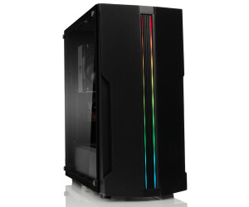
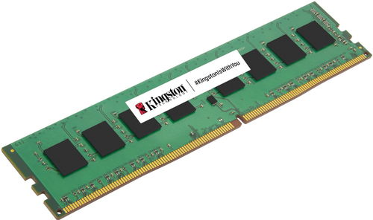
Motivation: recommending based on history
Components
Design
?
Composed of
Task: based on previous designs, propose components for a partially completed design.
Hildebrandt et al., Configuration of industrial automation solutions using multi-relational recommender systems, 2018

Slide 7
So… how can we do this?
What we want to build is a recommender system. Lets look at the Netflix example:
Movies
Users
Watched / Ranked
This is a discrete structure. But we can find vector embeddings that allow us to make recommendations!
$$e_{user i}^{T}e_{movie j}≈score for matching user i and movie j$$

Slide 8
Content
PageRank
Singular Value Decomposition
Funk Algorithm
Non-negative Matrix Factorization
DeepWalk
Knowledge graphs
Open and closed world assumption
Tensor factorization
Translational embeddings
Graph Neural Networks

Slide 9
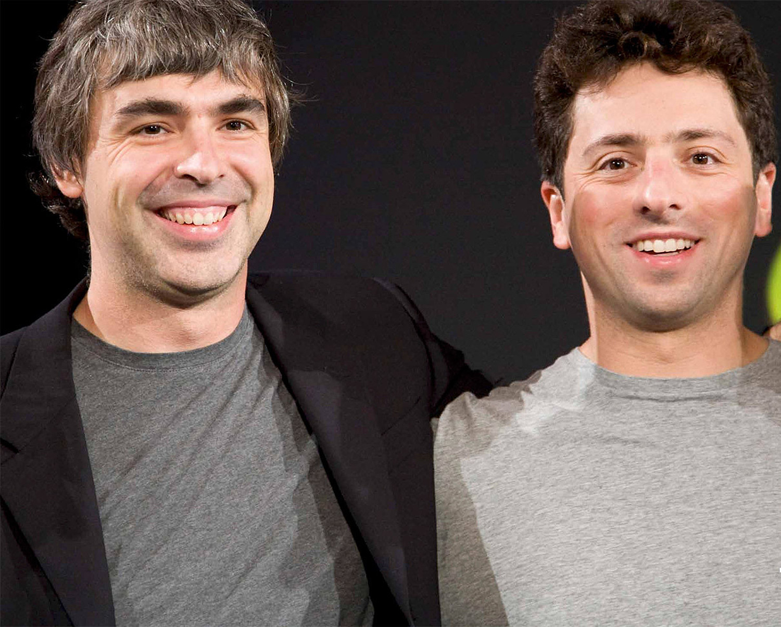

The secret sauce of early Google: PageRank
Larry Page (1973 - )
& Sergey Brin (1973 - )
Problem: You search webpages containing a certain “term”, but you are overwhelmed by the number of results…
So, what can we do?
Idea: sort the webpages by relevance!
The importance of any web page can be judged by looking at the pages that link to it.

Slide 10

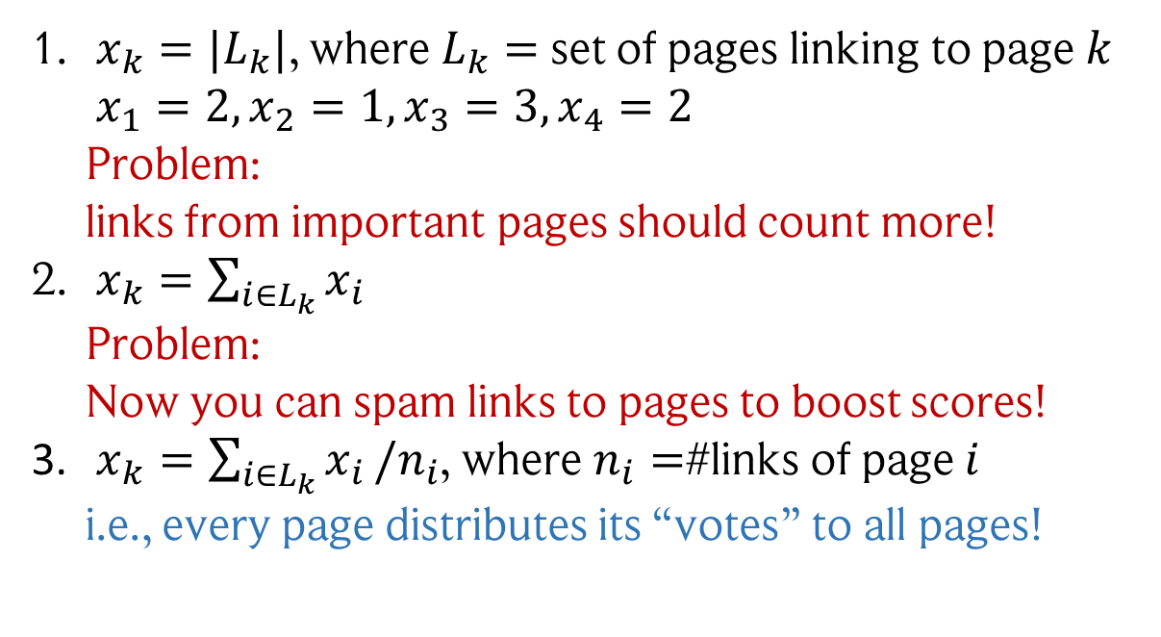
The internet: a graph of pages linking to each other
Larry Page (1973 - )
& Sergey Brin (1973 - )
Let’s define an importance score of each webpage: $x_{k}$
How do we get this score? Some ideas…
$x_{k}=|L_{k}|$, where $L_{k}=$ set of pages linking to page $k$ $x_{1}=2, x_{2}=1, x_{3}=3, x_{4}=2$ Problem: links from important pages should count more!
$x_{k}=\sum_{i∈L_{k}}{x_{i}}$ Problem: Now you can spam links to pages to boost scores!
$x_{k}=\sum_{i∈L_{k}}{x_{i}}/n_{i}$, where $n_{i}=$#links of page $i$ i.e., every page distributes its “votes” to all pages!
1
3
2
4
Vertices: Webpages Edges: Links to…
Source: The IT Crowd Sitcom

Slide 11
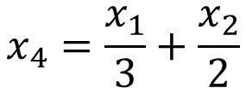
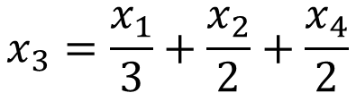
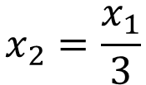
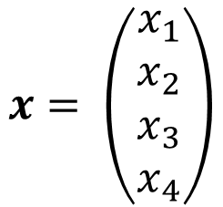
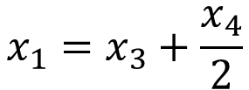
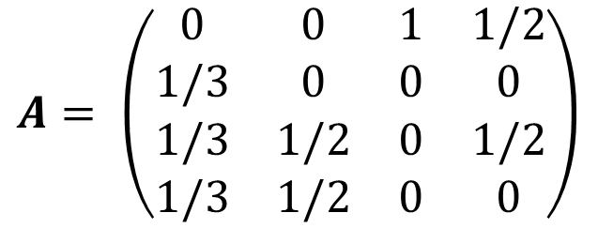
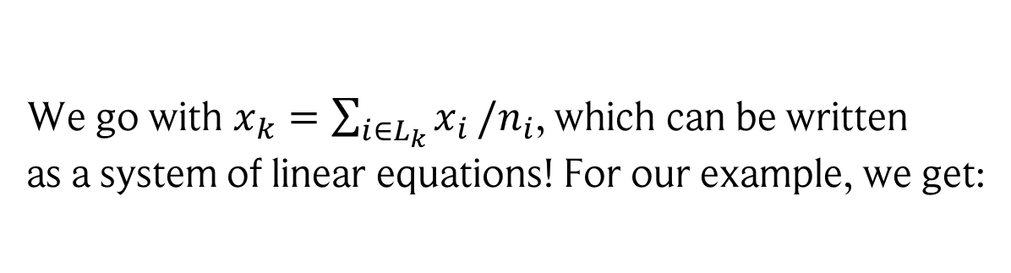
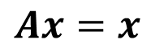
PageRank: turning ranking to an eigenvector problem
Larry Page (1973 - )
& Sergey Brin (1973 - )
We go with $x_{k}=\sum_{i∈L_{k}}{x_{i}}/n_{i}$, which can be written as a system of linear equations! For our example, we get:
$$x_{1}=x_{3}+\frac{x_{4}}{2}$$
$$x_{2}=\frac{x_{1}}{3}$$
$$x_{3}=\frac{x_{1}}{3}+\frac{x_{2}}{2}+\frac{x_{4}}{2}$$
$$x_{4}=\frac{x_{1}}{3}+\frac{x_{2}}{2}$$
1
3
Or rather:
$$Ax=x$$
$$A= \left(\begin{matrix}0 & 0 & 1 & 1/2 \\ 1/3 & 0 & 0 & 0 \\ 1/3 & 1/2 & 0 & 1/2 \\ 1/3 & 1/2 & 0 & 0\end{matrix}\right)$$
$$x= \left(\begin{matrix}x_{1} \\ x_{2} \\ x_{3} \\ x_{4}\end{matrix}\right)$$
2
4
Vertices: Webpages Edges: Links to…
Source: The IT Crowd Sitcom

Slide 12
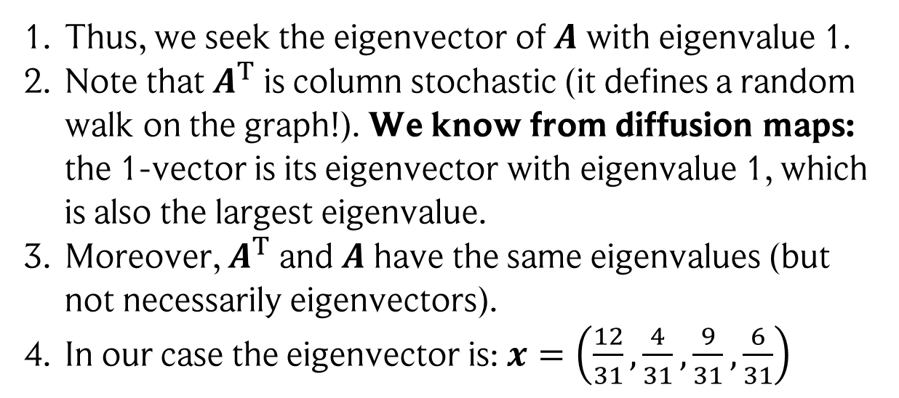
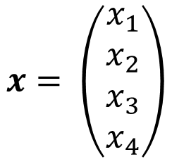
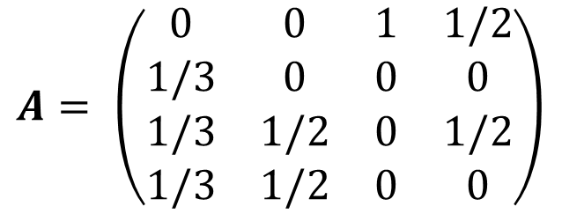
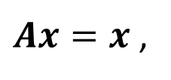
PageRank: turning ranking to an eigenvector problem
Larry Page (1973 - )
& Sergey Brin (1973 - )
$$A= \left(\begin{matrix}0 & 0 & 1 & 1/2 \\ 1/3 & 0 & 0 & 0 \\ 1/3 & 1/2 & 0 & 1/2 \\ 1/3 & 1/2 & 0 & 0\end{matrix}\right)$$
$$x= \left(\begin{matrix}x_{1} \\ x_{2} \\ x_{3} \\ x_{4}\end{matrix}\right)$$
$Ax=x$ ,
Thus, we seek the eigenvector of $A$ with eigenvalue 1.
Note that $A^{T}$ is column stochastic (it defines a random walk on the graph!). We know from diffusion maps: the 1-vector is its eigenvector with eigenvalue 1, which is also the largest eigenvalue.
Moreover, $A^{T}$ and $A$ have the same eigenvalues (but not necessarily eigenvectors).
In our case the eigenvector is: $x=\left(\frac{12}{31},\frac{4}{31},\frac{9}{31},\frac{6}{31}\right)$
1
3
2
4
Vertices: Webpages Edges: Links to…

Slide 13
Recommender systems
Using PageRank, we can recommend the most famous webpages!
In particular, its another example of how a graph problem turns into an eigenvalue problem!
But what about cases like this?
Movies
Users
Watched / Ranked

Slide 14
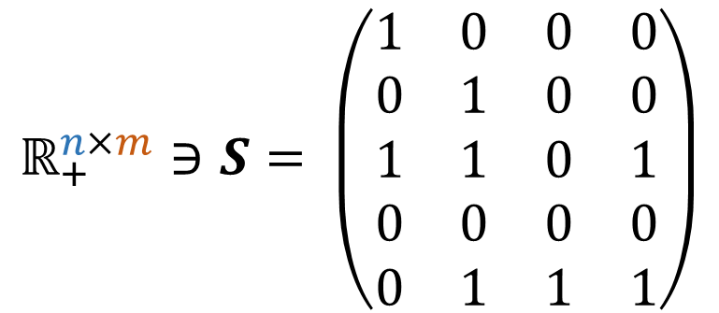




Representing our problem as a user-movie matrix
Let’s represent this in a different way!
Movies
Users
User 1
$$ℝ_{+}^{n×m}∋S= \left(\begin{matrix}1 & 0 & 0 & 0 \\ 0 & 1 & 0 & 0 \\ 1 & 1 & 0 & 1 \\ 0 & 0 & 0 & 0 \\ 0 & 1 & 1 & 1\end{matrix}\right)$$
$$U∈ℝ^{n×d}$$
$$≈U⋅M$$
$$M∈ℝ^{d×m}$$
$$d<n,m$$
Movie 1

Slide 15
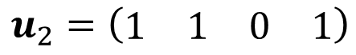
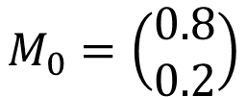

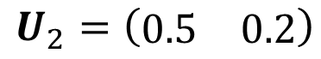

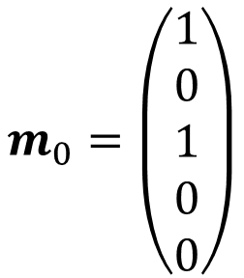
Finding vector embeddings for users and movies
What are $U$ and $M$?
They are called embeddings / latent representations of the users and movies!
It’s low-dimensional vectors that contain collaborative information from all users/movies.
Embeddings
Original representation
Rows and columns of $S$
Entries contain global information! For users, it could be genres they like For movies, how much they align with that genre
$$u_{2}=\left(\begin{matrix}1 & 1 & 0 & 1\end{matrix}\right)$$
Movies watched by user 2
No information about other users!
$$U_{2}=\left(\begin{matrix}0.5 & 0.2\end{matrix}\right)$$
$$M_{0}=\left(\begin{matrix}0.8 \\ 0.2\end{matrix}\right)$$
$$m_{0}=\left(\begin{matrix}1 \\ 0 \\ 1 \\ 0 \\ 0\end{matrix}\right)$$
Often, the elements are not cleanly interpretable though!
Users that watched movie 0
No information about other movies!

Slide 16
Question!
How can we find such embeddings?!

Slide 17
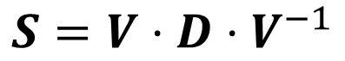
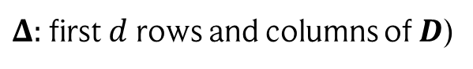
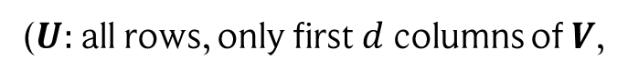
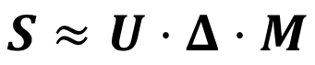
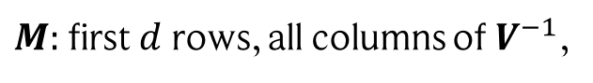
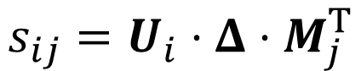
First idea: spectral decomposition!
Reminder: If a matrix $S$ is diagonalizable, we can represent it in the following way
$$S=V⋅D⋅V^{−1}$$
User embeddings
Feature importance (diagonal matrix)
Movie embeddings
However, we don’t want to perfectly reproduce the original matrix!
Truncate! I.e., only keep the $d$ highest eigenvalues:
$$S≈U⋅Δ⋅M$$
($U:$ all rows, only first $d$ columns of $V$,
$M:$ first $d$ rows, all columns of $V^{−1}$,
$Δ:$ first $d$ rows and columns of $D$)
$$s_{ij}=U_{i}⋅Δ⋅M_{j}^{T}$$
Scoring a new users-movie combination $i\text{−}j$?

Slide 18

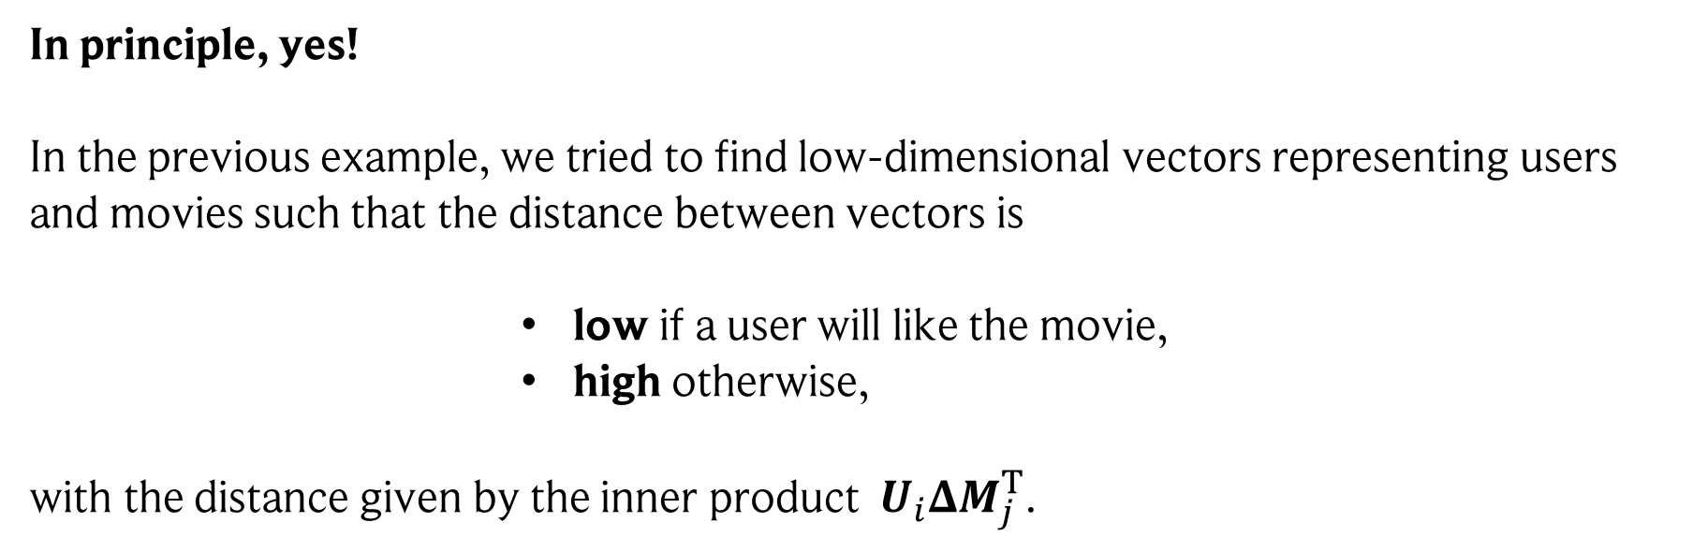
Isn’t this just dimensionality reduction?
In principle, yes! In the previous example, we tried to find low-dimensional vectors representing users and movies such that the distance between vectors is
low if a user will like the movie,
high otherwise,
with the distance given by the inner product $U_{i}ΔM_{j}^{T}$.

Slide 19
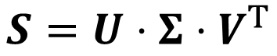
Singular Value Decomposition (SVD) to the rescue!
A decomposition that always works is SVD!
SVD: Let $S∈ℝ^{n×m}$. Then there exists a $U∈ℝ^{n×n}$, $V∈ℝ^{m×m}$, and $Σ∈ℝ^{n×m}$, such that
$$S=U⋅Σ⋅V^{T}$$
Where $Σ$ has $σ_{i}$, the square-roots of the eigenvalues of $S^{T}S$, on its diagonal and is 0 otherwise, and $U^{T}U=I$, $V^{T}V=I$. $σ_{i}$ are called singular values of $S$.
Proof: see handwritten notes

Slide 20

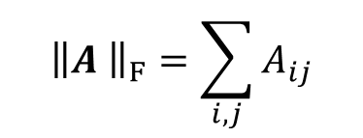

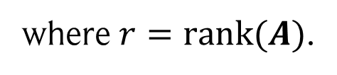
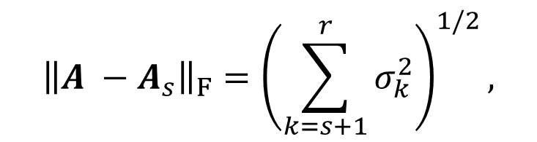
An important property!
Let $A∈ℝ^{n×m}$ with SVD $A=U Σ V^{T}$. Moreover, let $A_{s}$ be the matrix reconstructed from the truncated SVD, i.e., using only the $s$ largest singular values, $A_{s}=\sum_{k=1}^{s}{σ_{k}}u_{k}v_{k}^{T}$.
Then, among all matrices with rank $s$, $A_{s}$ is the best possible approximation of $A$ with respect to the Frobenius and Operator norm.
In particular, the approximation error is:
$${\left\|A −A_{s}\right\|}_{F}={\left(\sum_{k=s+1}^{r}{σ_{k}^{2}}\right)}^{1/2},$$
$${\left\|A −A_{s}\right\|}_{2}=σ_{s+1} ,$$
where $r=rank(A)$.
Details: see handwritten notes
$${\left\|A \right\|}_{F}=\sum_{i,j}{A_{ij}}$$
Reminder:
Frobenius norm
Operator norm
$${\left\|A \right\|}_{2}=\sup_{\left|\left|x\right|\right|=1}{|\left|Ax\right||}$$

Slide 21
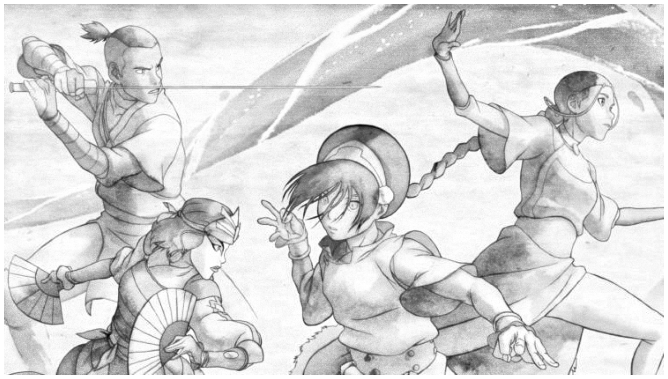
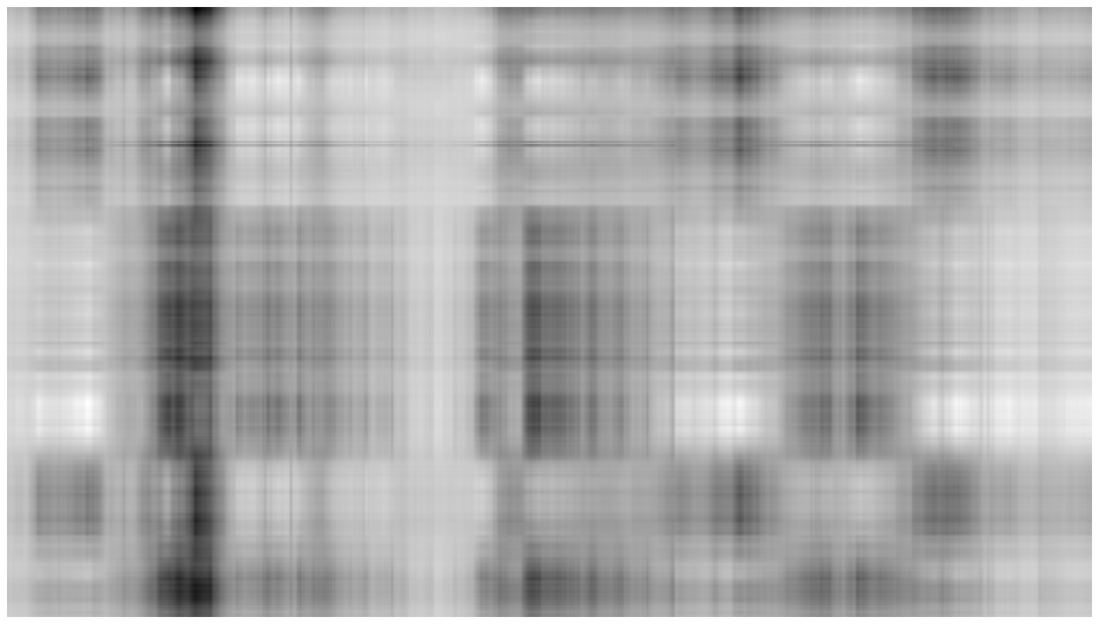
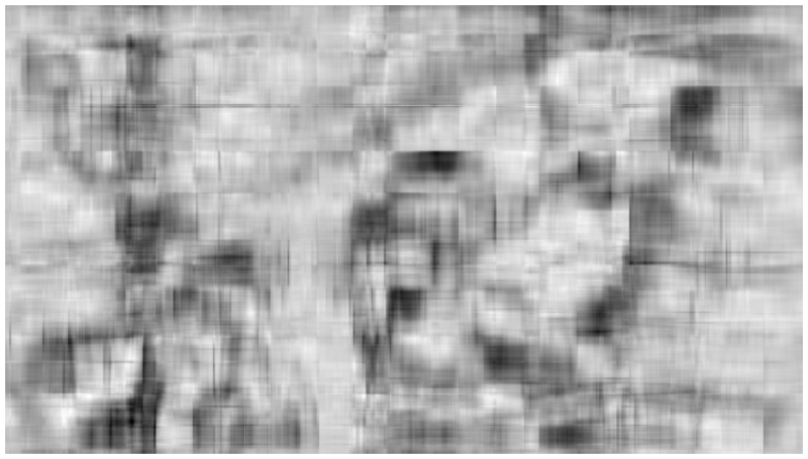
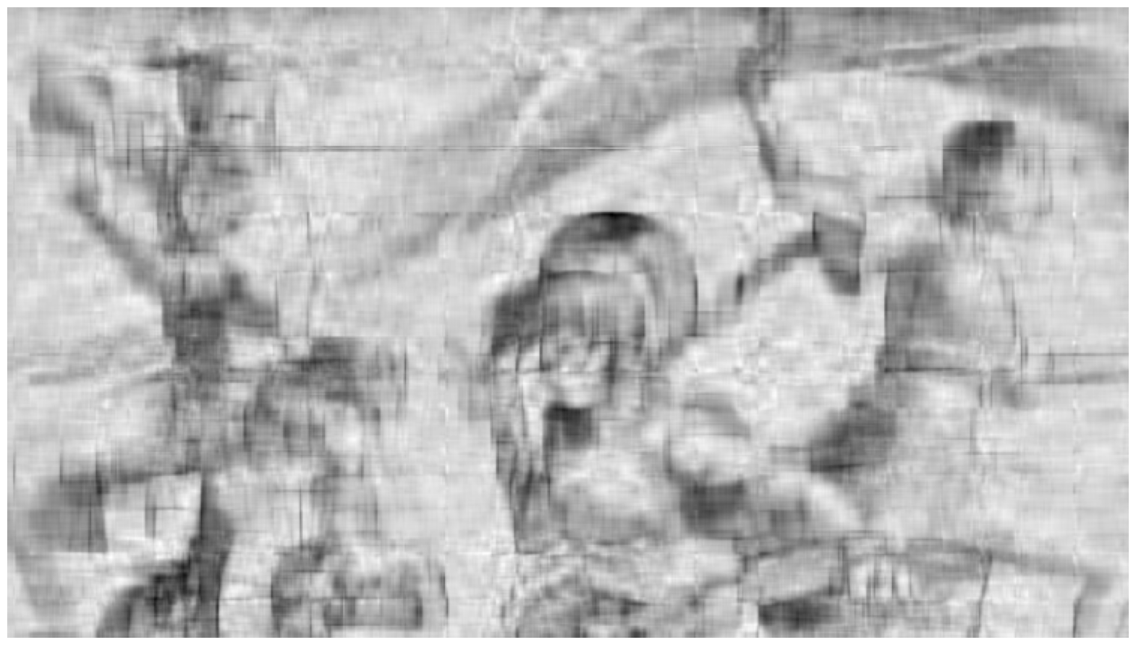
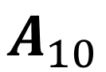
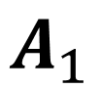
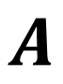
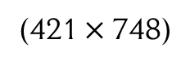
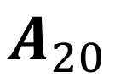
Example using images
$$A$$
$$A_{1}$$
(421 $×$ 748)
$$A_{10}$$
$$A_{20}$$

Slide 22
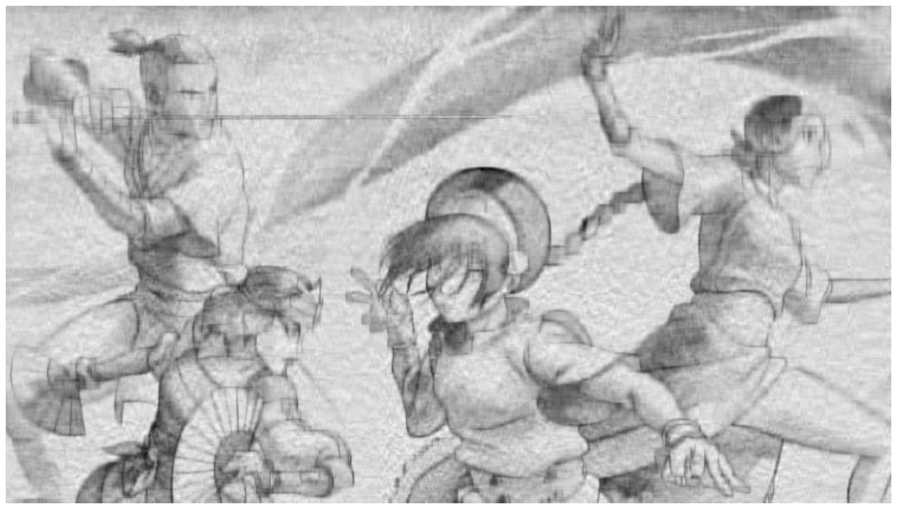

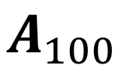
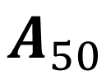
Example using images
This is lossy compression!
Useful for:
Memory reduction (compression)
Noise reduction / removal
Filling in missing values!
$$A$$
(421 $×$ 748)
$$A_{50}$$
$$A_{100}$$

Slide 23
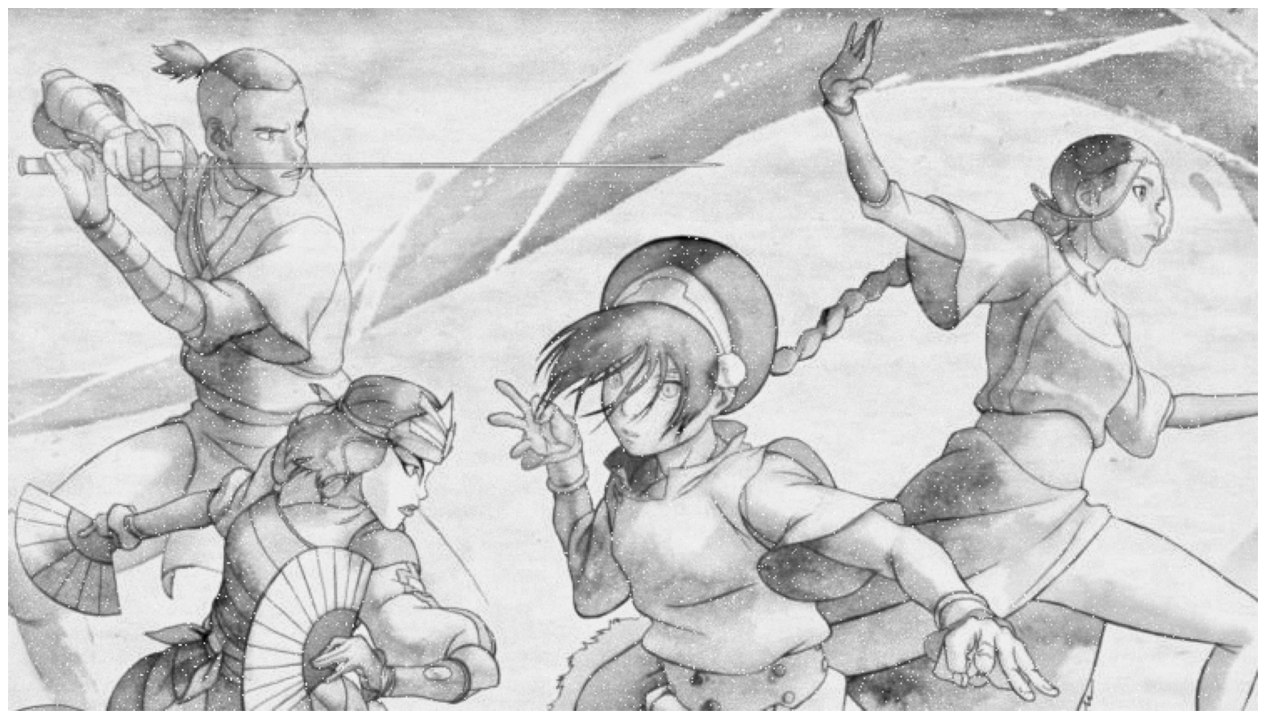


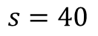
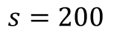
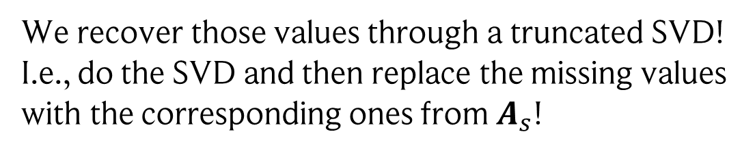
“Recommending” missing pixel values
Here, some pixels have missing values which we filled with 0.
$$s=200$$
$$s=40$$
We recover those values through a truncated SVD! I.e., do the SVD and then replace the missing values with the corresponding ones from $A_{s}$!
Truncating is key, else we recover the original 0s we added!

Slide 24

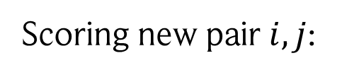
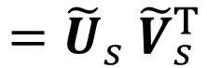


Images are matrices, as is our user-movie score matrix!
Movies
Users
User embeddings
Movie embeddings
User 1
truncate!
$$ℝ_{+}^{n×m}∋S= \left(\begin{matrix}1 & 0 & 0 & 0 \\ 0 & 1 & 0 & 0 \\ 1 & 1 & 0 & 1 \\ 0 & 0 & 0 & 0 \\ 0 & 1 & 1 & 1\end{matrix}\right)$$
$$≈U_{s}\sqrt{{ Σ}_{s}}\sqrt{{ Σ}_{s}}{ V}_{s}^{T}$$
$$={\tilde{U}}_{s} {\tilde{V}}_{s}^{T}$$
Scoring new pair $i,j$:
$$s_{ij}={\tilde{U}}_{s,i}{\tilde{V}}_{s,j}^{T}$$
Movie 1

Slide 25





What if… all our matrix entries are positive…?
Daniel D. Lee & Sebastian Seung
In that case, a factorization algorithm exists with a multiplicative update rule that is guaranteed to converge!
Non-negative Matrix Factorization (NMF): Given a non-negative matrix $V$, find non-negative matrices $W$ and $H$ such that
$$V≈WH$$
This can be achieved by minimizing ${\left\|V −WH\right\|}^{2}=\sum_{ij}{{\left(V_{ij}−{\left(WH\right)}_{ij}\right)}^{2}}$
This term is nonincreasing under the following updates:
$$H_{ij}←H_{ij}\frac{{\left(W^{T}V\right)}_{ij}}{{\left(W^{T}WH\right)}_{ij}}$$
$$W_{ij}←W_{ij}\frac{{\left(VH^{T}\right)}_{ij}}{{\left(WHH^{T}\right)}_{ij}}$$
and $V = WH$is a fixed point of both update rules.
Proof: see handwritten notes

Slide 26



Second version of NMF
Daniel D. Lee & Sebastian Seung
Note: there is a second optimization goal and set of update rules!
$$D(V||WH)=\sum_{ij}{\left(V_{ij}\log\left(\frac{V_{ij}}{{\left(WH\right)}_{ij}}\right)−V_{ij}+{\left(WH\right)}_{ij}\right)}$$
Minimizing the divergence
In case
$\sum_{ij}{V_{ij}=\sum_{ij}{{\left(WH\right)}_{ij}=1}}$, i.e., the matrices form proper probability distributions,
this is the Kullback-Leibler divergence!
The divergence is nonincreasing under the following updates:
$$H_{ij}←H_{ij}\frac{\sum_{k}{W_{ki}V_{kj}/{\left(WH\right)}_{kj}}}{\sum_{k}{W_{ki}}}$$
$$W_{ij}←W_{ij}\frac{\sum_{k}{H_{jk}V_{ik}/{\left(WH\right)}_{ik}}}{\sum_{k}{H_{jk}}}$$
and $V = WH$is again a fixed point of both update rules.

Slide 27


Comparison with PCA
$$W×V_{i}^{T}=reconstructed image i$$
A column of the second matrix
First non-negative matrix
Low-dimensional representation (weighting of eigenvectors)
Eigenvectors from PCA (the first few resemble faces, so we could call them “eigenfaces”)
Only additive composition (no negative values): thus, localized features emerge (not the case for PCA)!
Lee & Seung, Learning the parts of objects by non-negative matrix factorization, Nature 1999

Slide 28
There are some problems though…
We had to provide “filler” values for the missing data, which adds bias…
Fully decomposing huge matrices is computationally expensive…
In particular, real data will be incredibly sparse, which SVD does not utilize…
To solve this, we will go back to 2006, when Netflix posted a challenge to improve their recommender system (back then, they borrowed DVDs).

Slide 29

Netflix challenge: Funk SVD (won the 3rd prize!)
To improve SVD, the idea is rather simple: Instead of doing actual SVD, we just run an optimizer to find appropriate embeddings!
First, some notation:
$s_{ij}:$ score given by user i to movie j; $D=\{\left(i,j\right):we know s_{ij}\}$
$u_{i}$: vector embedding of user $i$
$m_{j}$: vector embedding of movie $j$
$b_{i}$: bias of user $i$ (i.e., how critical is this user compared to others?)
$B_{j}$: bias of movie $j$ (i.e., how famous is this movie compared to others?)
Funk SVD then optimizes the following objective:
$$\min_{u, m, b, B}L={\frac{1}{2}\sum_{i,j∈D }{{\left( s_{ij}−u_{i}^{T}m_{j}−b_{i}−B_{j}\right)}^{2}+\frac{1}{2}\sum_{i,j}{λ⋅\left({\left\|u_{i}\right\|}^{2}+{\left\|m_{j}\right\|}^{2}+b_{i}^{2}+B_{j}^{2}\right)}}}$$
Matrix factorization, just like SVD!
Regularisation to avoid overfitting!
Hyperparameter we choose!

Slide 30





How do we optimize this? Gradient descent!
The concept is very simple:
calculate the gradient (direction of steepest slope) of L and make a step in this direction to update
all parameters.
Basically: parameter updates = going downhill
$$u_{i}←u_{i}−η ∇_{u_{i}}L$$
$$m_{i}←m_{i}−η ∇_{m_{i}}L$$
$$b_{i}←b_{i}−η ∇_{b_{i}}L$$
$$B_{i}←B_{i}−η ∇_{B_{i}}L$$
step size or “learning rate”
Image: https://mriquestions.com/back-propagation.html, 2025

Slide 31







Update rule for Funk SVG
Our loss:
$$L={\frac{1}{2}\sum_{i,j∈D }{{\left( s_{ij}−u_{i}^{T}m_{j}−b_{i}−B_{j}\right)}^{2}+\frac{1}{2}\sum_{i,j}{λ⋅\left({\left\|u_{i}\right\|}^{2}+{\left\|m_{j}\right\|}^{2}+b_{i}^{2}+B_{j}^{2}\right)}}}$$
$$s_{ij}−u_{i}^{T}m_{j}−b_{i}−B_{j}$$
For simplicity, we introduce the error:
if $i,j∈D$
$$ε_{ij}=$$
$$0$$
else (actually, the error is undefined as we have no ground truth)
We then get:
$$u_{k}←u_{k}+η \left(\sum_{j}{ε_{kj}}m_{j}−λu_{k}\right)$$
$$m_{k}←m_{k}+η \left(\sum_{j}{ε_{jk}}u_{j}−λm_{k}\right)$$
$$b_{k}←b_{k}+η \left(\sum_{j}{ε_{kj}}−λb_{k}\right)$$
$$B_{k}←B_{k}+η \left(\sum_{j}{ε_{jk}}−λB_{k}\right)$$

Slide 32

Let’s mimic the Netflix challenge!
We use the MovieLens-100k dataset:
100,000 ratings from 1000 users on 1700 movies. We use a 100x400 subset here.
Movies
Table = Matrix = Image
Movie 1 | Movie 2 | Movie 3 | …
0.5 | ? | 0.2 | 0
? | 1 | 0 | 0.2
0 | 0 | 1 | ?
Users
Scores given by users
To test, we hold-out some of the scores and see how well our model predicts them (with the mean-squared error!)

Slide 33

Performance of Funk SVD on hold-out data
Our result is not perfect, but we extracted the trend!
The model really struggles with overfitting…
If we are only interested in recommending matching movies, those with high test score are at the top of the list!
To achieve this, we only used the score matrix!
We did not use any other information, such as the structure of the bipartite graph.
We did not use any meta-information.
Everything was done using linear models.
We will look at these next

Slide 34




How can we embed nodes just using graph structure?
Basically: nodes with a similar “neighbourhood” should be mapped to similar vectors.
?
Does that sound familiar? Any idea how we could achieve this?
Similar idea than for Diffusion Maps: We perform random walks on the graph!
Adjacency matrix:
Transition matrix:
3
$$A= \left(\begin{matrix}0 & 1 & 0 & 0 \\ 1 & 0 & 1 & 1 \\ 0 & 1 & 0 & 1 \\ 0 & 1 & 1 & 0\end{matrix}\right)$$
$$M=D^{−1}A$$
1
4
$M_{ij}:$ prob. to jump from node $i$ to node $j$
2
Degree matrix:
$$D_{ii}=\sum_{j}{A_{ij}}$$
Perozzi et al., Deepwalk: Online Learning of Social Representations (2014)

Slide 35







First step of DeepWalk: create “dataset” of random walks
Select a random node $P_{i}=\frac{D_{ii}}{Tr(D)}$
Starting from the sampled node, sample a walk of length $L$ using $M$
Repeat 1.-2. $n$ times
4
5
4
5
4
5
4
5
3
3
3
3
$$i \sim P$$
$$p\left(2→k\right)=M_{2k}$$
1
6
1
6
1
6
1
6
2
2
2
2
$$p\left(1→2\right)=1$$
$$i \sim P$$
4
5
4
5
4
5
4
5
3
3
3
3
1
6
1
6
1
6
1
6
2
2
2
2
$$p\left(5→k\right)=M_{5k}$$
$$p\left(6→k\right)=M_{6k}$$
Perozzi et al., Deepwalk: Online Learning of Social Representations (2014)

Slide 36
Second step: calculating embeddings
We now have several sequences of vertices!
…
1
2
3
6
5
…
5
6
3
4
3
…
3
6
5
3
2
…
Embeddings are found using the Skip-gram algorithm.
Perozzi et al., Deepwalk: Online Learning of Social Representations (2014)

Slide 37

Intermezzo: Skip-gram
Skip-gram is a word-embedding method. It aims at embedding each word to a vector, such that words that occur together within a context window of $±T$ words have similar embeddings!
Example: context window of size $T=3$ around “the”
This is a test sentence to illustrate the idea and ensure you understand it.
Example: do “illustrate” and “understand” co-occur in this sentence? NO
This is a test sentence to illustrate the idea and ensure you understand it.
We define: $P\left(w, c\right)=\frac{e^{v_{w}^{T}⋅v_{c}}}{\sum_{(a,b)}{e^{v_{a}^{T}⋅v_{b}}}}$
= the probability of $w$ and $c$ co-occurring!
Problem: the denominator sums over all words… this can become unwieldy!
Mikolov et al., Distributed Representations of Words and Phrases and their Compositionality (2013)

Slide 38




Intermezzo: Skip-gram
Instead, we define: $P\left(w, c\right)=σ(v_{w}^{T}⋅v_{c})$ with $σ\left(x\right)={\left(1+e^{−x}\right)}^{−1}$
The embeddings are found by maximizing $\log\left(σ\left(v_{w}^{T}⋅v_{c}\right)\right)+k E_{b∼P_{N}}(\log{σ(−v_{w}^{T}⋅v_{b})})$
Increase probability for observed $(w,c)$ pairs!
To avoid the normalization factor, generate $k$ “negative samples” that should have low probability!
These are sampled from $$P_{N}\left(b\right)=\frac{\#b}{\#pairs}$$
Obtained from the text data! Basically: fraction of times words $b$ occurs in the word pairs extracted from the text.
Note: we could even use different embeddings for the “target” word and “context” words: $v_{w}^{T}⋅u_{c}$
Mikolov et al., Distributed Representations of Words and Phrases and their Compositionality (2013)

Slide 39

Idea: replace words by … nodes in our random walks!
Instead, we define: $P\left(w, c\right)=σ(v_{w}^{T}⋅v_{c})$ with $σ\left(x\right)={\left(1+e^{−x}\right)}^{−1}$
The embeddings are found by maximizing $\log\left(σ\left(v_{w}^{T}⋅v_{c}\right)\right)+k E_{b∼P_{N}}(\log{σ(−v_{w}^{T}⋅v_{b})})$
1
2
3
6
5
…
5
6
3
4
3
$P\left(w, c\right)=$ probability to see node $w$ and node $c$ co-occurring!
…
3
6
5
3
2
…
?
Is this related to matrix factorization?
Perozzi et al., Deepwalk: Online Learning of Social Representations (2014)

Slide 40



DeepWalk implicitly factorizes a matrix we know
DeepWalk is equivalent to factorizing the matrix:
$$S_{wc}=\log\left(\frac{P(w,c)}{P\left(w\right)⋅P(c)}\right)−\log{k}=\log\left(\frac{Tr\left(D\right)}{T}\left(\sum_{r=1}^{T}{M^{r}}\right)D^{−1}\right)−\log{k }$$
with
$P(w,c)$: frequency of (w,c) co-occurring in random walks.
$P(x)$: frequency of node x occurring in random walks.
$k$: number of negative samples.
This is also known as pointwise mutual information!
Proof: see handwritten notes
This is also true for many other embedding algorithms!
Qiu et al., Network Embedding as Matrix Factorization: Unifying DeepWalk, LINE, PTE, and node2vec (2018)

Slide 41








Ok, so far we only looked at non-relational data
Relational data can be represented as a knowledge graph: edges have different types, and nodes and edges can have “features”
wasBornIn
hasGenre
watched
For instance, in addition to user behaviour, we enrich our graph with meta information about users and movies!

Slide 42







Another example: industrial automation factory
tcp
4841
Archive
hasPort
hasProtocol
hasSrc
hasDst
connection1
192.168.0.17
Developers
hasIP
Manufacturing
192.168.0.3
hasIP
hosts
voltageA
writes
Repository
serves
app1
Edge devices
PLC
serves
measures
Sensor
currentC
static engineering data
+ dynamic network data
+ dynamic app data
192.168.0.3
192.168.0.17
edgePC
edgePC
edgePC
app1
…
hasType
hasType
hasType
hasIP
hosts
hasType
…
ipAddress
ipAddress
device
192.168.0.17
app1
industrialApp
…
Note: here we actually turned things around! We built a recommender system to find anomalies – anomalies = links we would never recommend!
Soler Garrido, Dold, Frank, Machine learning on knowledge graphs for context-aware security monitoring (2021)

Slide 43


Another example: molecules!
Image credit: Yin Fang et al., Knowledge graph-enhanced molecular contrastive learning with functional prompt (Nature Machine Intelligence, 2023)

Slide 44
In-depth view with a simple example
Raw knowledge graph:
Alternative representation: triples (subject – predicate – object)
Jedi Knight
hasProfession
Carrie Fisher
Carrie Fisher
P. Amidala
…
hasProfession
plays
hasChild
…
Actor
Leia Organa
Leia Organa
…
P. Amidala
A. Skywalker
hasChild
Leia Organa
plays
Carrie Fisher
appearsIn
hasProfession
Actor
Star Wars
What can we learn from this type of data?
Node classification
Carrie Fisher
A. Skywalker
Real or Fictional
?
Link prediction: predict new links!
Our recommender system setting!
Carrie Fisher
A. Skywalker
appearsIn
hasChild
Star Wars
Carrie Fisher
?
Graph classification
?
Molecule
HasProperty
?

Slide 45
There are some challenges though…!
Looking at real world knowledge graphs, they often have
thousands to millions of nodes
that are only very sparsely connected.
There are two ways how we can treat this situation!
Closed-world assumption (CWA)
Open-world assumption (OWA)
?
?
?
We want to score unknown edges, so we go with OWA!
Edges missing is the ground-truth.
We don’t know if edges should be missing or not.

Slide 46






RESCAL: representing knowledge graphs as tensors
Our knowledge graph is basically a list of triplets (s, p, o), which we can encode in a tensor as follows:
$1$ if the link (i,j,k) is part of our graph
$$X_{ijk}=$$
$0$ otherwise
$$X=$$
entities
This is the same idea we used for user-movie rankings! $X_{ij}$ would be that, we just added one more dimension for different edge types!
entities
relations
Hence, we can use the same idea! Factorize the tensor using low-rank elements!
Nickel et al., A Three-Way Model for Collective Learning on Multi-Relational Data (2011)

Slide 47









RESCAL: Tensor factorization
Our approach for doing this looks incredibly similar to SVD, NMF, Funk SVD, etc.
$e_{i}:$ vector embedding of node $i$
$$X_{ijk}≈e_{i}^{T}R_{j}e_{k}$$
$R_{j}:$ matrix embedding of edge type $j$
$$R_{j}$$
$$e_{k}$$
$$X$$
$$e_{i}^{T}$$
How do we get the embeddings?
$$\sum_{\left(i,j,k\right)∈KG}{{\left\|X_{ijk}−e_{i}^{T}R_{j}e_{k}\right\|}^{2}}$$
, e.g., using gradient descent.
Minimize
Do you see any problem with this approach?
all triplets in our knowledge graph KG
Nickel et al., A Three-Way Model for Collective Learning on Multi-Relational Data (2011)

Slide 48



RESCAL: Negative sampling
How do we get the embeddings?
$$\sum_{\left(i,j,k\right)∈KG}{{\left\|X_{ijk}−e_{i}^{T}R_{j}e_{k}\right\|}^{2}}$$
, e.g., using gradient descent.
Minimize
!
This is trivially solved by finding embeddings that result in${ e}_{i}^{T}R_{j}e_{k}=1$ for all i,j,k!
But we can fix this by adding “negative samples” to the mix:
sample from uniform distr.
$$\sum_{\left(i,j,k\right)∈KG}{{\left\|X_{ijk}−e_{i}^{T}R_{j}e_{k}\right\|}^{2}}+\sum_{l=1}^{n_{s}}{{\left\|e_{r}^{T}R_{j}e_{k}\right\|}^{2}{\left.​\right|}_{r\sim P} }+\sum_{l=1}^{n_{o}}{{\left\|e_{i}^{T}R_{j}e_{r}\right\|}^{2}{\left.​\right|}_{r\sim P} }$$
Minimize
So, for every true triplet, corrupt either the subject or object to obtain “counter”-examples that should be scored with 0. We only sample a few ($n_{s}+n_{o})$ to not slip into the CWA!

Slide 49








Taking some steps back…
For RESCAL, we decompose our tensor into a product of vectors and matrices:
$$X_{ijk}≈e_{i}^{T}R_{j}e_{k}$$
This is an example of a tensor train decomposition!
Given a tensor $X∈ℝ^{n_{1}×…×n_{r}}$, a tensor train decomposition of $X$ has the form:
$$X_{i_{1}…i_{r}}=\sum_{α_{1},…,α_{r−1}}{V_{i_{1}α_{1}}^{(1)}V_{α_{1}i_{2}α_{2}}^{\left(2\right)}…V_{α_{r−2}i_{r−1}α_{r−1}}^{\left(r−1\right)}V_{α_{r−1}i_{r} }^{\left(r\right)}}$$
In case of RESCAL: Node embeddings ($i_{1}$/ $i_{r}$ = subject and predicate node) and relation embeddings ($i_{2}$= edge type)
Schematically, it looks like this:
$$X=$$
$$×$$
$$×$$
$$×$$
$$×$$
$$×$$
$r$ times

Slide 50
Can we always find a tensor train decomposition?
Yes! This is called the Tensor Train (TT) SVD. We will only motivate it briefly here.
First, lets define the flattening / matricization of a tensor $X$:
Basically: we single out one dimension and flatten the rest into a second, single dimension, turning the tensor into a matrix!
$X_{i_{1}…i_{r}}→$ $X_{i_{1},i_{2}…i_{r}}$
Then we can find a Tensor decomposition by iteratively applying flattening and SVD:
$X_{i_{1}…i_{r}}→$ $X_{i_{1} ,{ i}_{2}…i_{r}}=U^{(1)}Σ^{(1)}V^{(1)}$
with ${ U}^{(1)}∈ ℝ^{n_{1}×r_{1}},Σ^{\left(1\right)}V^{(1)}∈ ℝ^{r_{1}×i_{2}×…×i_{r}}$
$${\left(Σ^{\left(1\right)}V^{\left(1\right)}\right)}_{α_{2}i_{2}…i_{r}}→{\left(Σ^{\left(1\right)}V^{\left(1\right)}\right)}_{α_{2}i_{2} , { i}_{3}…i_{r}}=U^{(2)}Σ^{(2)}V^{(2)}$$
and so on…
Oseledets & Trytyshnikov, Breaking the Curse of Dimensionality, Or How to Use SVD in Many Dimensions (2009)

Slide 51





Beyond factorization: translational embeddings (TransE)
Next to factorization, translational models are very famous. A classic one is TransE (with lots of variations existing!)
The idea: entities are points, and relations are translations between these points.
Example:
Our score function then is:
$X_{spo}={\left\|e_{s}+r_{p}−e_{o}\right\|}^{L}$ for $L∈ℕ$
$$x_{1}$$
Consultant
Dominik
where a low value means that the triplet $(s,p,o)$ has a high likelihood to be true.
hasProfession
Lecturer
We usually find the embeddings using a margin loss, i.e., we demand that true triplets have far lower score than negative samples, with a gap $γ$ separating them (similar idea as for SVMs!).
$$x_{0}$$

Slide 52
There is a problem!
With our factorization approach, we have so far ignored one problem…
?
What if, after factorization, a new user joins for whom no embedding exists?
Clearly one can just refactor the new matrix that includes the user… we need to refactor often in production, as our model does not generalize to unseen “nodes”… Is there another way?

Slide 53








Inductive models: entering graph neural networks
Graph neural networks are a type of model that can deal with this!
We will focus on the “graph” part and treat neural networks in more detail later.
So for now, a neural network is simply a non-linear function $f_{θ}(x)$ with continuous parametrization $θ$.
A graph neural network (GNN) $G$ is designed to respect the symmetries of graph structures: a GNN is invariant to the order of nodes of the graph (permutation invariance).
$$($$
$$)$$
$$($$
$$)$$
$$G$$
$$=$$
$$G$$

Slide 54




The three steps of graph neural networks
How is this achieved?
First, every node has a feature vector $h_{i}^{(0)}$.
A GNN performs three steps to update the node features:
$$h_{0}^{(0)}$$
$$h_{3}^{(0)}$$
$$h_{1}^{\left(0\right)}$$
$$h_{2}^{(0)}$$

Slide 55












The three steps of graph neural networks
How is this achieved?
First, every node has a feature vector $h_{i}^{(0)}$.
A GNN performs three steps to update the node features:
$$m_{03}^{(1)}$$
1. Message passing along edges:
$$h_{0}^{(0)}$$
$$h_{3}^{(0)}$$
$m_{ij}^{(l)}←MSG\left(h_{i}^{\left(l−1\right)},h_{j}^{\left(l−1\right)}\right)$
$$m_{30}^{(1)}$$
$$m_{01}^{(1)}$$
$$m_{10}^{(1)}$$
$$m_{32}^{(1)}$$
$$m_{23}^{(1)}$$
$$m_{12}^{(1)}$$
$$h_{1}^{\left(0\right)}$$
$$h_{2}^{(0)}$$
$$m_{21}^{(1)}$$
“Messages” m are being passed between nodes.
Meaning node 1 learns about the features of its neighbours!

Slide 56






The three steps of graph neural networks
How is this achieved?
First, every node has a feature vector $h_{i}^{(0)}$.
A GNN performs three steps to update the node features:
$$a_{0}^{(1)}$$
$$m_{03}^{(1)}$$
1. Message passing along edges:
$$h_{0}^{(0)}$$
$$h_{3}^{(0)}$$
$m_{ij}^{(l)}←MSG\left(h_{i}^{\left(l−1\right)},h_{j}^{\left(l−1\right)}\right)$
$$m_{30}^{(1)}$$
$$a_{3}^{(1)}$$
$$m_{01}^{(1)}$$
$$m_{10}^{(1)}$$
$$m_{32}^{(1)}$$
2. Aggregation:
$$m_{23}^{(1)}$$
neighbours of node $i$
$$a_{1}^{(1)}$$
$a_{i}^{(l)}←AGG\left(\left\{m_{ij}^{\left(l\right)} | j∈𝒩(i)\right\}\right)$
$$m_{12}^{(1)}$$
$$h_{1}^{\left(0\right)}$$
$$h_{2}^{(0)}$$
$$m_{21}^{(1)}$$
$$a_{2}^{(1)}$$
Take the messages of all neighbours and “aggregate” them into one vector!

Slide 57





The three steps of graph neural networks
How is this achieved?
First, every node has a feature vector $h_{i}^{(0)}$.
A GNN performs three steps to update the node features:
$$a_{0}^{(1)}$$
1. Message passing along edges:
$$h_{0}^{(1)}$$
$$h_{3}^{(1)}$$
$m_{ij}^{(l)}←MSG\left(h_{i}^{\left(l−1\right)},h_{j}^{\left(l−1\right)}\right)$
$$a_{3}^{(1)}$$
2. Aggregation:
neighbours of node $i$
$$a_{1}^{(1)}$$
$a_{i}^{(l)}←AGG\left(\left\{m_{ij}^{\left(l\right)} | j∈𝒩(i)\right\}\right)$
$$h_{1}^{\left(1\right)}$$
$$h_{2}^{(1)}$$
$$a_{2}^{(1)}$$
3. Update node features:
$h_{i}^{(l+1)}←UPD\left(h_{i}^{(l)}, a_{i}^{(l)}\right)$
Assign each node a new feature using the aggregated message. Each node feature now contains information about its 1-hop neighbourhood!

Slide 58

The three steps of graph neural networks
How is this achieved?
First, every node has a feature vector $h_{i}^{(0)}$.
A GNN performs three steps to update the node features:
1. Message passing along edges:
$m_{ij}^{(l)}←MSG\left(h_{i}^{\left(l−1\right)},h_{j}^{\left(l−1\right)}\right)$
MSG, UPD are usually neural networks.
AGG is different: it has to be permutation invariant, e.g., $AGG(x,y) = AGG(y,x)$
2. Aggregation:
neighbours of node $i$
$a_{i}^{(l)}←AGG\left(\left\{m_{ij}^{\left(l\right)} | j∈𝒩(i)\right\}\right)$
E.g., a simple sum or average satisfies this!
3. Update node features:
$h_{i}^{(l+1)}←UPD\left(h_{i}^{(l)}, a_{i}^{(l)}\right)$

Slide 59

The full graph neural network
Doing these steps once is “1 layer” of a graph neural network.
We usually repeat this $k$ times. After $k$ iterations, the features of nodes contain information about other nodes that are at most k-hops (links) away from them!
Thus, through these iterations we “enrich” the node features using local aggregation!
0-hop
1-hop
2-hop
3-hop

Slide 60

The full graph neural network
After $k$ steps, one then uses a permutation invariant READOUT function that takes the aggregated features $h_{i}^{(k)}$ as input and produces the final output.
Note that this way, the whole GNN is permutation invariant. In fact, operations are only performed between nodes, independent of the number of nodes.
Thus, we can apply a GNN to any graph with similar structure (e.g., same number of initial node features, same number of edge types, etc.)!
In the recommender system setting, that means we can handle new content without retraining / refactorizing everything…!

Slide 61

Expressivity of graph neural networks
What can we learn using graph neural networks? There is a very simple result on that!
Let $φ$be a graph neural network and $G_{1}$, $G_{2}$ two non-isomorphic graphs. If $φ\left(G_{1}\right)≠φ\left(G_{2}\right),$then the Weisfeiler-Lehman test also decides that $G_{1}$, $G_{2}$ are not isomorphic.
In other terms: GNNs are at most as good as the Weisfeiler-Lehman (WL) test at distinguishing graphs. If the WL test cannot distinguish two graphs, then the GNN cannot distinguish them either, producing the same output for both!
So, what is the Weisfeiler-Lehman test?
K. Xu, W. Hu, J. Leskovec, S. Jegelka. How powerful are graph neural networks? ICLR 2019

Slide 62


The 1-dimensional Weisfeiler-Lehman (WL) test
Problem: You have two graphs $G_{1}$ and $G_{2}$, and you would like to know if they are the same. Of course, the nodes are labelled differently, so we have to find an isomorphic (1-to-1) mapping that assigns each node in $G_{1}$ its counterpart in $G_{2}$.
There is currently no algorithm that solves this! But the WL can be used to figure out, in many cases, if two graphs are not isomorphic.
How it works:
Step 0: Initialize both graphs the same way
Assign features to all nodes. Here, we use a compressed representation by just labelling nodes that have the same features (here, we use the label 1).
If all nodes are identical, they start all with the same label.
Image credit: https://davidbieber.com/post/2019-05-10-weisfeiler-lehman-isomorphism-test/

Slide 63

The 1-dimensional Weisfeiler-Lehman (WL) test
Problem: You have two graphs $G_{1}$ and $G_{2}$, and you would like to know if they are the same. Of course, the nodes are labelled differently, so we have to find an isomorphic (1-to-1) mapping that assigns each node in $G_{1}$ its counterpart in $G_{2}$.
There is currently no algorithm that solves this! But the WL can be used to figure out, in many cases, if two graphs are not isomorphic.
How it works:
Step 1: Message and aggregate
For each node, look at neighbouring nodes and aggregate a multiset of their features.
Image credit: https://davidbieber.com/post/2019-05-10-weisfeiler-lehman-isomorphism-test/

Slide 64


The 1-dimensional Weisfeiler-Lehman (WL) test
Problem: You have two graphs $G_{1}$ and $G_{2}$, and you would like to know if they are the same. Of course, the nodes are labelled differently, so we have to find an isomorphic (1-to-1) mapping that assigns each node in $G_{1}$ its counterpart in $G_{2}$.
There is currently no algorithm that solves this! But the WL can be used to figure out, in many cases, if two graphs are not isomorphic.
How it works:
Step 2: Update
Map all multisets to new labels. This has to be injective: different multisets are always mapped to different labels! Here, we mapped: $$\left\{1,1\right\}→2, \left\{1,1,1\right\}→3$$
Image credit: https://davidbieber.com/post/2019-05-10-weisfeiler-lehman-isomorphism-test/

Slide 65

The 1-dimensional Weisfeiler-Lehman (WL) test
Problem: You have two graphs $G_{1}$ and $G_{2}$, and you would like to know if they are the same. Of course, the nodes are labelled differently, so we have to find an isomorphic (1-to-1) mapping that assigns each node in $G_{1}$ its counterpart in $G_{2}$.
There is currently no algorithm that solves this! But the WL can be used to figure out, in many cases, if two graphs are not isomorphic.
How it works:
Repeat step 2 and 3
We do this $k$ times or until the distribution of labels does not change between steps. If at any step, the multiset of all labels of $G_{1}$ and $G_{2}$ is different, we stop and the test decides that the two graphs are not isomorphic. Otherwise, the test is inconclusive.
2: 3
3: 2
2: 3
3: 2
Image credit: https://davidbieber.com/post/2019-05-10-weisfeiler-lehman-isomorphism-test/

Slide 66

The 1-dimensional Weisfeiler-Lehman (WL) test
Problem: You have two graphs $G_{1}$ and $G_{2}$, and you would like to know if they are the same. Of course, the nodes are labelled differently, so we have to find an isomorphic (1-to-1) mapping that assigns each node in $G_{1}$ its counterpart in $G_{2}$.
There is currently no algorithm that solves this! But the WL can be used to figure out, in many cases, if two graphs are not isomorphic.
How it works:
Repeat step 2 and 3
We do this $k$ times or until the distribution of labels does not change between steps. If at any step, the multiset of all labels of $G_{1}$ and $G_{2}$ is different, we stop and the test decides that the two graphs are not isomorphic. Otherwise, the test is inconclusive.
2: 3
3: 2
2: 3
3: 2
Image credit: https://davidbieber.com/post/2019-05-10-weisfeiler-lehman-isomorphism-test/

Slide 67


The 1-dimensional Weisfeiler-Lehman (WL) test
Problem: You have two graphs $G_{1}$ and $G_{2}$, and you would like to know if they are the same. Of course, the nodes are labelled differently, so we have to find an isomorphic (1-to-1) mapping that assigns each node in $G_{1}$ its counterpart in $G_{2}$.
There is currently no algorithm that solves this! But the WL can be used to figure out, in many cases, if two graphs are not isomorphic.
How it works:
Repeat step 2 and 3
We do this $k$ times or until the distribution of labels does not change between steps. If at any step, the multiset of all labels of $G_{1}$ and $G_{2}$ is different, we stop and the test decides that the two graphs are not isomorphic. Otherwise, the test is inconclusive.
4: 2
5: 1
6: 2
4: 2
5: 1
6: 2
Image credit: https://davidbieber.com/post/2019-05-10-weisfeiler-lehman-isomorphism-test/

Slide 68

The 1-dimensional Weisfeiler-Lehman (WL) test
Problem: You have two graphs $G_{1}$ and $G_{2}$, and you would like to know if they are the same. Of course, the nodes are labelled differently, so we have to find an isomorphic (1-to-1) mapping that assigns each node in $G_{1}$ its counterpart in $G_{2}$.
There is currently no algorithm that solves this! But the WL can be used to figure out, in many cases, if two graphs are not isomorphic.
How it works:
Repeat step 2 and 3
We do this $k$ times or until the distribution of labels does not change between steps. If at any step, the multiset of all labels of $G_{1}$ and $G_{2}$ is different, we stop and the test decides that the two graphs are not isomorphic. Otherwise, the test is inconclusive.
4: 2
5: 1
6: 2
4: 2
5: 1
6: 2
Image credit: https://davidbieber.com/post/2019-05-10-weisfeiler-lehman-isomorphism-test/

Slide 69

The 1-dimensional Weisfeiler-Lehman (WL) test
Problem: You have two graphs $G_{1}$ and $G_{2}$, and you would like to know if they are the same. Of course, the nodes are labelled differently, so we have to find an isomorphic (1-to-1) mapping that assigns each node in $G_{1}$ its counterpart in $G_{2}$.
There is currently no algorithm that solves this! But the WL can be used to figure out, in many cases, if two graphs are not isomorphic.
How it works:
Repeat step 2 and 3
We do this $k$ times or until the distribution of labels does not change between steps. If at any step, the multiset of all labels of $G_{1}$ and $G_{2}$ is different, we stop and the test decides that the two graphs are not isomorphic. Otherwise, the test is inconclusive.
7: 2
8: 1
9: 2
7: 2
8: 1
9: 2
Image credit: https://davidbieber.com/post/2019-05-10-weisfeiler-lehman-isomorphism-test/

Slide 70


Example 1: when it works
$$G_{1}$$
$$G_{2}$$

Slide 71










Example 1: when it works
$$G_{1}$$
$$G_{2}$$
1
1
1
1
1
1
Message + Aggregate
$$\{1,1\}$$
1
1
1
1
1
1
$$\{1\}$$
$$\{1,1\}$$
$$\{1\}$$
$$\{1,1\}$$
$$\{1,1\}$$
Update
$$\left\{1\right\}→2$$
Label distribution
$$\left\{1,1\right\}→3$$
3
2: 2
3: 1
$$G_{1}$$
$$G_{2}$$
3: 3
2
3
2
Graphs are different!
3
3

Slide 72
Example 2: when it doesn’t work
These two graphs are clearly not identical, as we can cut the left one into two separate parts with only one cut, while the right one requires at least two cuts to do so! Let’s run 1-WL and see if it agrees!

Slide 73
















Example 2: when it doesn’t work
These two graphs are clearly not identical, as we can cut the left one into two separate parts with only one cut, while the right one requires at least two cuts to do so! Let’s run 1-WL and see if it agrees!
Message + aggregate
$$\{1,1\}$$
$$\{1,1\}$$
$$\{1,1,1\}$$
$$\{1,1\}$$
$$\{1,1\}$$
1
$$\{1,1,1\}$$
1
1
1
1
$$\{1,1\}$$
1
1
1
1
1
1
$$\{1,1\}$$
$$\{1,1\}$$
$$\{1,1\}$$
1
$$\{1,1,1\}$$
1
1
1
1
$$\{1,1\}$$
$$\{1,1\}$$
$$\{1,1\}$$
$$\{1,1,1\}$$
$$\{1,1\}$$

Slide 74




















Example 2: when it doesn’t work
These two graphs are clearly not identical, as we can cut the left one into two separate parts with only one cut, while the right one requires at least two cuts to do so! Let’s run 1-WL and see if it agrees!
Update
$$\left\{1,1\right\}→1$$
$$\{1,1\}$$
$$\{1,1\}$$
$$\{1,1,1\}$$
$$\left\{1,1,1\right\}→2$$
$$\{1,1\}$$
$$\{1,1\}$$
1
$$\{1,1,1\}$$
1
1
2
1
$$\{1,1\}$$
1
2
2
1
1
1
$$\{1,1\}$$
$$\{1,1\}$$
$$\{1,1\}$$
1
$$\{1,1,1\}$$
1
1
2
1
$$\{1,1\}$$
$$\{1,1\}$$
$$\{1,1\}$$
$$\{1,1,1\}$$
$$\{1,1\}$$
Check stopping condition:
$$1:6 \\ 2:2$$
$$1:6 \\ 2:2$$
Graph 1:
Graph 1:
Identical, so we continue…

Slide 75












Example 2: when it doesn’t work
These two graphs are clearly not identical, as we can cut the left one into two separate parts with only one cut, while the right one requires at least two cuts to do so! Let’s run 1-WL and see if it agrees!
Message + aggregate
$$\{1,2\}$$
$$\{1,2\}$$
$$\{1,1,2\}$$
$$\{1,2\}$$
$$\{1,2\}$$
1
$$\{1,1,2\}$$
1
1
2
1
$$\{1,1\}$$
1
2
2
1
1
1
$$\{1,1\}$$
$$\{1,1\}$$
$$\{1,1\}$$
1
$$\{1,1,2\}$$
1
1
2
1
$$\{1,2\}$$
$$\{1,2\}$$
$$\{1,2\}$$
$$\{1,1,2\}$$
$$\{1,2\}$$

Slide 76
















Example 2: when it doesn’t work
These two graphs are clearly not identical, as we can cut the left one into two separate parts with only one cut, while the right one requires at least two cuts to do so! Let’s run 1-WL and see if it agrees!
Update
$$\left\{1,1\right\}→1$$
$$\{1,2\}$$
$$\{1,2\}$$
$$\{1,1,2\}$$
$$\left\{1,2\right\}→2$$
$$\{1,2\}$$
$$\{1,2\}$$
$$\left\{1,1,2\right\}→3$$
2
$$\{1,1,2\}$$
2
2
3
2
$$\{1,1\}$$
1
3
3
1
1
1
$$\{1,1\}$$
$$\{1,1\}$$
$$\{1,1\}$$
2
$$\{1,1,2\}$$
2
2
3
2
$$\{1,2\}$$
$$\{1,2\}$$
$$\{1,2\}$$
$$\{1,1,2\}$$
$$\{1,2\}$$
Check stopping condition:
$$1:1 \\ 2:4 \\ 3:1$$
$$1:1 \\ 2:4 \\ 3:1$$
Graph 1:
Graph 1:
Identical, so we continue…

Slide 77
















Example 2: when it doesn’t work
These two graphs are clearly not identical, as we can cut the left one into two separate parts with only one cut, while the right one requires at least two cuts to do so! Let’s run 1-WL and see if it agrees!
Message + aggregate
$$\{1,3\}$$
$$\{1,3\}$$
$$\{2,2,3\}$$
$$\{1,3\}$$
$$\{1,3\}$$
2
$$\{2,2,3\}$$
2
2
3
2
$$\{2,2\}$$
1
3
3
1
1
1
$$\{2,2\}$$
$$\{2,2\}$$
$$\{2,2\}$$
2
$$\{2,2,3\}$$
2
2
3
2
$$\{1,3\}$$
$$\{1,3\}$$
$$\{1,3\}$$
$$\{2,2,3\}$$
$$\{1,3\}$$

Slide 78



















Example 2: when it doesn’t work
These two graphs are clearly not identical, as we can cut the left one into two separate parts with only one cut, while the right one requires at least two cuts to do so! Let’s run 1-WL and see if it agrees!
Update
$$\left\{2,2\right\}→1$$
$$\{1,3\}$$
$$\{1,3\}$$
$$\{2,2,3\}$$
$$\left\{1,3\right\}→2$$
$$\{1,3\}$$
$$\{1,3\}$$
$$\left\{2,2,3\right\}→3$$
2
$$\{2,2,3\}$$
2
2
3
2
$$\{2,2\}$$
1
3
3
1
1
1
$$\{2,2\}$$
$$\{2,2\}$$
$$\{2,2\}$$
2
$$\{2,2,3\}$$
2
2
3
2
$$\{1,3\}$$
$$\{1,3\}$$
$$\{1,3\}$$
$$\{2,2,3\}$$
$$\{1,3\}$$
Check stopping condition:
$$1:1 \\ 2:4 \\ 3:1$$
$$1:1 \\ 2:4 \\ 3:1$$
Graph 1:
Graph 1:
Identical to the results we got for the last step, so 1-WL failed to distinguish the two graphs!

Slide 79

Prove that GNNs distinguish graphs at most as good as 1-WL
Let $φ$be a graph neural network and $G_{1}$, $G_{2}$ two non-isomorphic graphs. If $φ\left(G_{1}\right)≠φ\left(G_{2}\right),$then the Weisfeiler-Lehman test also decides that $G_{1}$, $G_{2}$ are not isomorphic.
For simplicity, we will only sketch the proof here.
Main idea: assume we have two graphs $G_{1}$, $G_{2}$ and a GNN $φ$. We assume that $φ\left(G_{1}\right)≠φ\left(G_{2}\right),$ but that the 1-WL test does not distinguish the graphs.
We will show that this leads to a contradiction!
K. Xu, W. Hu, J. Leskovec, S. Jegelka. How powerful are graph neural networks? ICLR 2019

Slide 80
Prove that GNNs distinguish graphs at most as good as 1-WL
Iteration
GNN view
1-WL view
1
K. Xu, W. Hu, J. Leskovec, S. Jegelka. How powerful are graph neural networks? ICLR 2019

Slide 81








Prove that GNNs distinguish graphs at most as good as 1-WL
Iteration
GNN view
1-WL view
1
1. 1-WL inconclusive $→$if we pick a node in $G_{1}$, we can find a similar node in $G_{2}$!
$$l_{1}$$
$$l_{1}$$
$$l_{3}$$
$$l_{0}$$
$$l_{3}$$
$$l_{0}$$
$$\left\{l_{0}, \left\{l_{1},l_{3}\right\}\right\}$$
K. Xu, W. Hu, J. Leskovec, S. Jegelka. How powerful are graph neural networks? ICLR 2019

Slide 82








Prove that GNNs distinguish graphs at most as good as 1-WL
Iteration
GNN view
1-WL view
1
1. 1-WL inconclusive $→$if we pick a node in $G_{1}$, we can find a similar node in $G_{2}$!
$$l_{1}$$
$$l_{1}$$
$$l_{3}$$
$$l_{1}$$
$$l_{1}$$
$$l_{3}$$
2. GNN & 1-WL start with the same features $→$same is true for GNN features!
$$l_{0}$$
$$l_{3}$$
$$l_{0}$$
$$l_{0}$$
$$l_{3}$$
$$l_{0}$$
$$\left\{l_{0}, \left\{l_{1},l_{3}\right\}\right\}$$
$$\left\{l_{0}, \left\{l_{1},l_{3}\right\}\right\}$$
K. Xu, W. Hu, J. Leskovec, S. Jegelka. How powerful are graph neural networks? ICLR 2019

Slide 83














Prove that GNNs distinguish graphs at most as good as 1-WL
Iteration
GNN view
1-WL view
1
1. 1-WL inconclusive $→$if we pick a node in $G_{1}$, we can find a similar node in $G_{2}$!
$$l_{1}$$
$$l_{1}$$
$$l_{3}$$
$$l_{1}$$
$$l_{1}$$
$$l_{3}$$
2. GNN & 1-WL start with the same features $→$same is true for GNN features!
$$l_{0}$$
$$l_{3}$$
$$l_{0}$$
$$l_{0}$$
$$l_{3}$$
$$l_{0}$$
$$\left\{l_{0}, \left\{l_{1},l_{3}\right\}\right\}$$
$$\left\{l_{0}, \left\{l_{1},l_{3}\right\}\right\}$$
k
$$h_{1}$$
$$h_{1}$$
$$h_{3}$$
$${l′}_{1}$$
$${l′}_{1}$$
$${l′}_{3}$$
3. Assume the same is true at iteration k!
$$h_{0}$$
$$h_{3}$$
$$h_{0}$$
$${l′}_{0}$$
$${l′}_{3}$$
$${l′}_{0}$$
$$\left\{h_{0}, \left\{h_{1},h_{3}\right\}\right\}$$
$$\left\{{l′}_{0}, \left\{{l′}_{1},{l′}_{3}\right\}\right\}$$
K. Xu, W. Hu, J. Leskovec, S. Jegelka. How powerful are graph neural networks? ICLR 2019

Slide 84


Prove that GNNs distinguish graphs at most as good as 1-WL
Iteration
GNN view
1-WL view
1
1. 1-WL inconclusive $→$if we pick a node in $G_{1}$, we can find a similar node in $G_{2}$!
$$l_{1}$$
$$l_{1}$$
$$l_{3}$$
$$l_{1}$$
$$l_{1}$$
$$l_{3}$$
2. GNN & 1-WL start with the same features $→$same is true for GNN features!
$$l_{0}$$
$$l_{3}$$
$$l_{0}$$
$$l_{0}$$
$$l_{3}$$
$$l_{0}$$
$$\left\{l_{0}, \left\{l_{1},l_{3}\right\}\right\}$$
$$\left\{l_{0}, \left\{l_{1},l_{3}\right\}\right\}$$
k
$$h_{1}$$
$$h_{1}$$
$$h_{3}$$
$${l′}_{1}$$
$${l′}_{1}$$
$${l′}_{3}$$
3. Assume the same is true at iteration k!
$$h_{0}$$
$$h_{3}$$
$$h_{0}$$
$${l′}_{0}$$
$${l′}_{3}$$
$${l′}_{0}$$
$$\left\{h_{0}, \left\{h_{1},h_{3}\right\}\right\}$$
$$\left\{{l′}_{0}, \left\{{l′}_{1},{l′}_{3}\right\}\right\}$$
How is node 0 updated in graph 1 and graph 2? $G_{1}$: $h_{0}^{(k+1)}$ $= UPD\left(AGG\left(h_{0}, MSG\left(h_{1}, h_{3}\right)\right)\right)$ $G_{2}$: $h_{0}^{(k+1)}$ $= UPD\left(AGG\left(h_{0}, MSG\left(h_{1}, h_{3}\right)\right)\right)$
As READOUT is permutation invariant, we thus have: $φ\left(G_{1}\right)=φ\left(G_{2}\right)$,
a contradiction!
The same! And because of 1., this is true for all nodes!
K. Xu, W. Hu, J. Leskovec, S. Jegelka. How powerful are graph neural networks? ICLR 2019

Slide 85

Graph neural networks as good (or better) than 1-WL?
Yes! The way we defined GNNs, they are as powerful as 1-WL if the MSG+AGG, UPD, and READOUT are injective functions!
Then the GNN always maps different multisets to different labels, just like 1-WL.
But can GNNs go beyond 1-WL? Yes!
By tracking node identities, so we can distinguish “identical” neighbourhoods that are in different locations in the graph. Thus, we attach a unique “identifier” (e.g., one-hot coded vector $e_{i}$) to each node label ($h_{i}^{(0)}⊕e_{i}$), basically giving them names :)
2
6
6
2
1
4
5
7
3
5
4
8
3
8
1
7
Problem: Now our GNN is not permutation invariant anymore, meaning that it does not generalize to different graphs! :(

Slide 86














Matrix (factorization) Reloaded
Can we give nodes unique “identifiers” while keeping permutation invariance?
Assume our graph has adjacency matrix $A$
with singular value decomposition $A=U ΣV^{T}$
Permuting nodes in the graph = permuting columns and rows of $A$!
This leads to a permutation of rows in $U$.
Graph
$$A$$
$$U$$
$$i$$
$$j$$
$( )$
$( )$
$$j$$
$$i$$
$$i$$
$$i$$
$$j$$
$$j$$

Slide 87



Matrix (factorization) Reloaded
If all singular values are distinct, then the eigenvectors (columns of $U$) are unique up to the sign.
$$−u_{1}$$
$$u_{1}$$
Thus, we do the following: we randomly multiply the columns of $U$ by $±1$, and then use the rows of this matrix as identifiers for our nodes!
$$φ(G, h_{i}^{\left(0\right)}⊕{\left(UΓ\right)}_{i}^{T})$$
with $Γ_{ii}∼Uniform\left(\left\{−1,1\right\}\right), Γ_{ij}=0 if i≠j$
Then $E\left(φ\left(G, h_{i}^{\left(0\right)}⊕{\left(UΓ\right)}_{i}^{T}\right)\right)=$ $E\left(φ\left(G′, h_{i}^{\left(0\right)}⊕{\left(UΓ\right)}_{i}^{T}\right)\right)$ if $G, G’$are isomorphic.
Note: We can also use other decompositions than SVD, e.g., of the graph Laplacian $L$ (Diffusion Maps, DeepWalk, …)

